Slide 1

[ ]
지도 기반 SNS
천호범 권용호 박준용 윤동민 권회윤 임주엽 최대호

Slide 2
Part 0
목차
1. User
2. Main Board
3. Map
4. Group Board

Slide 3
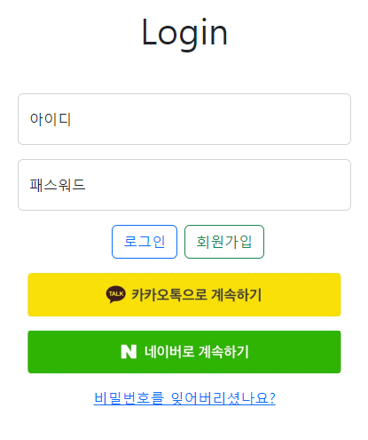
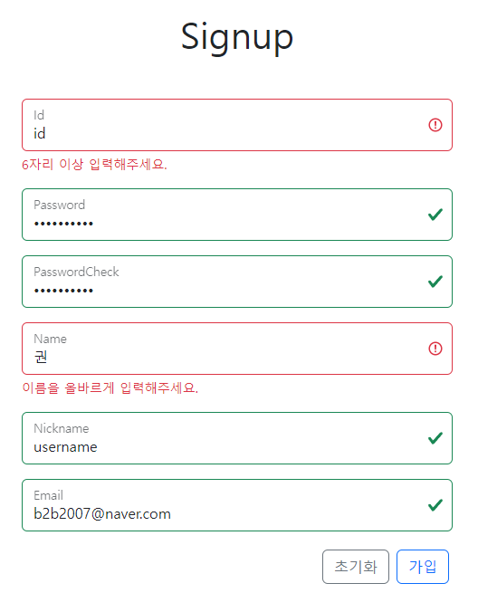
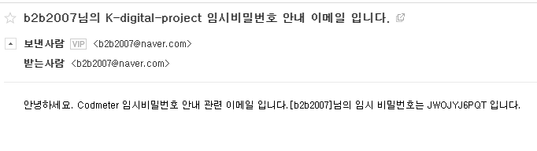
Part 1
User

Slide 4
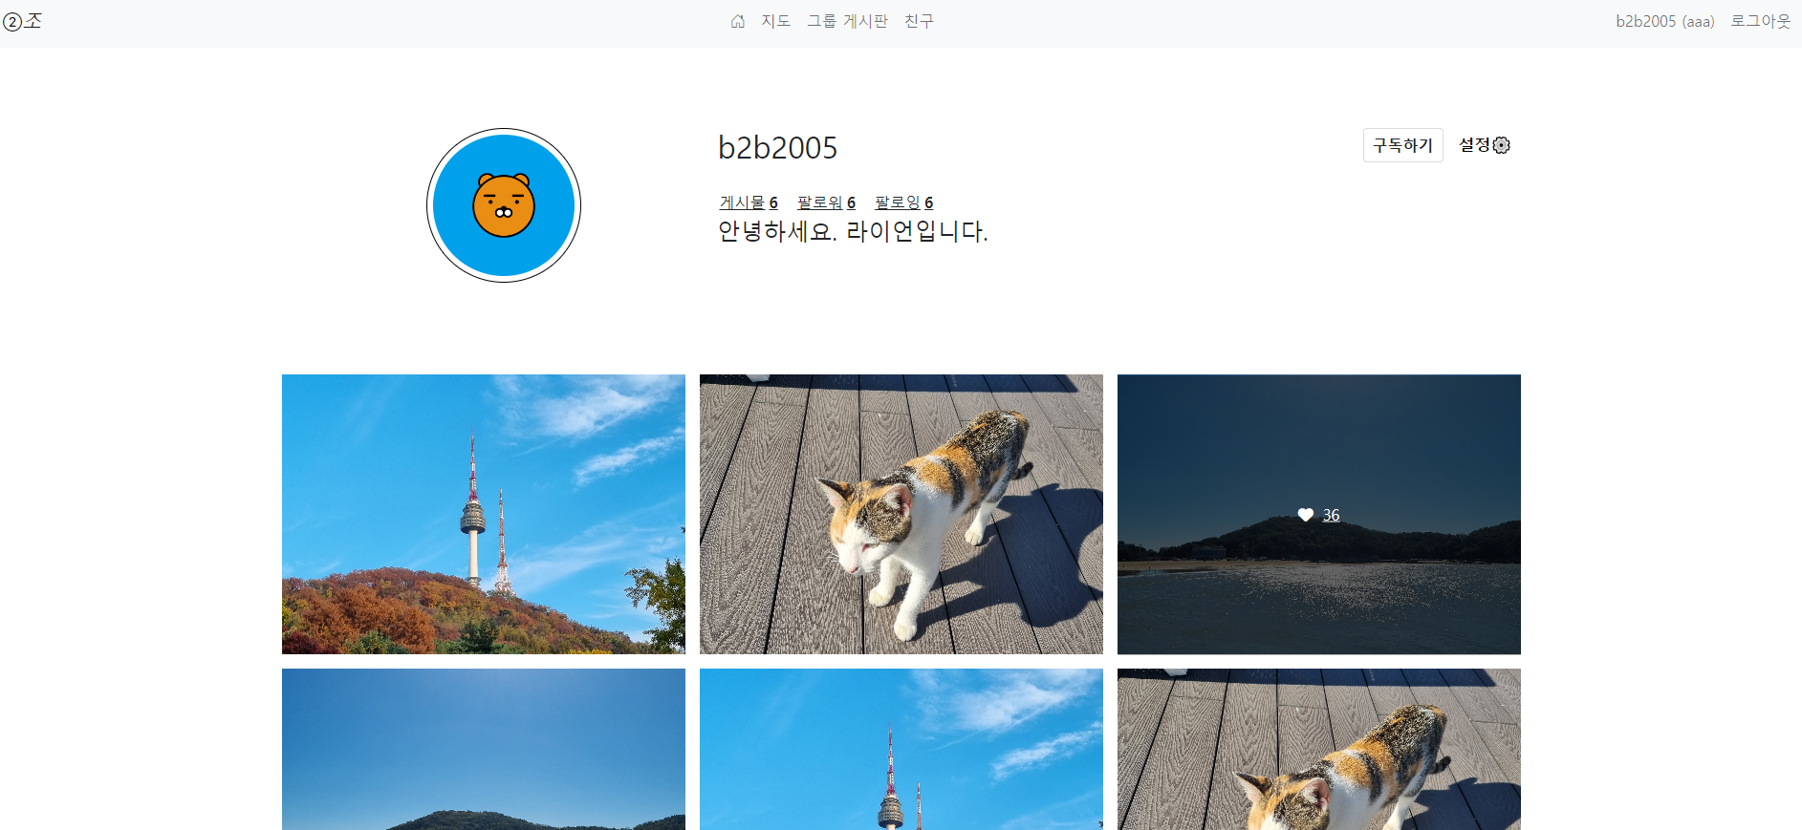
User

Slide 5
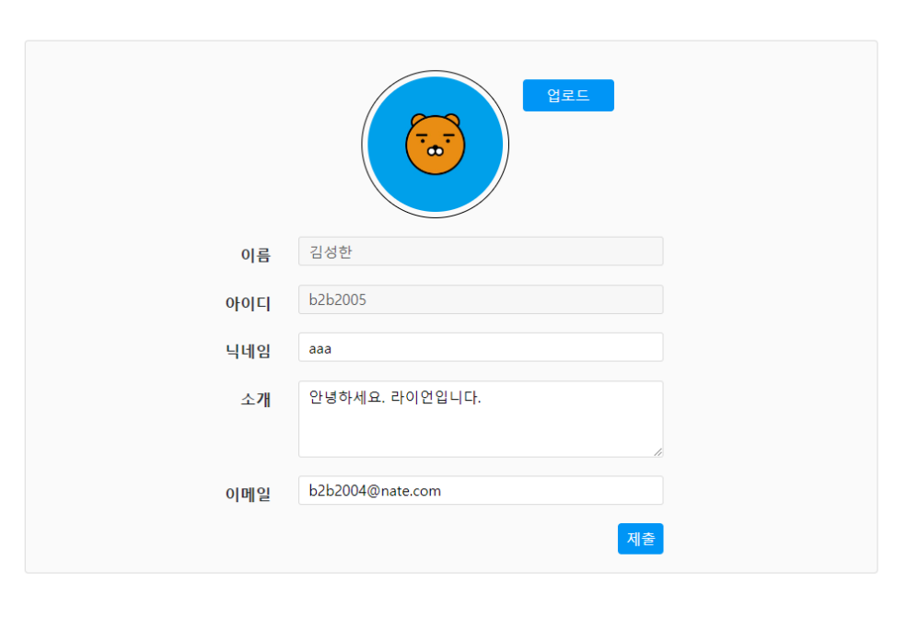
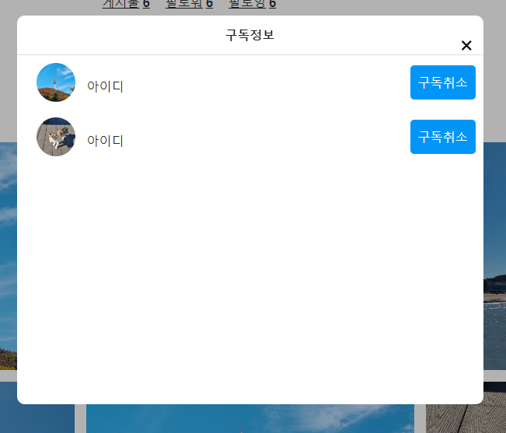
User

Slide 6
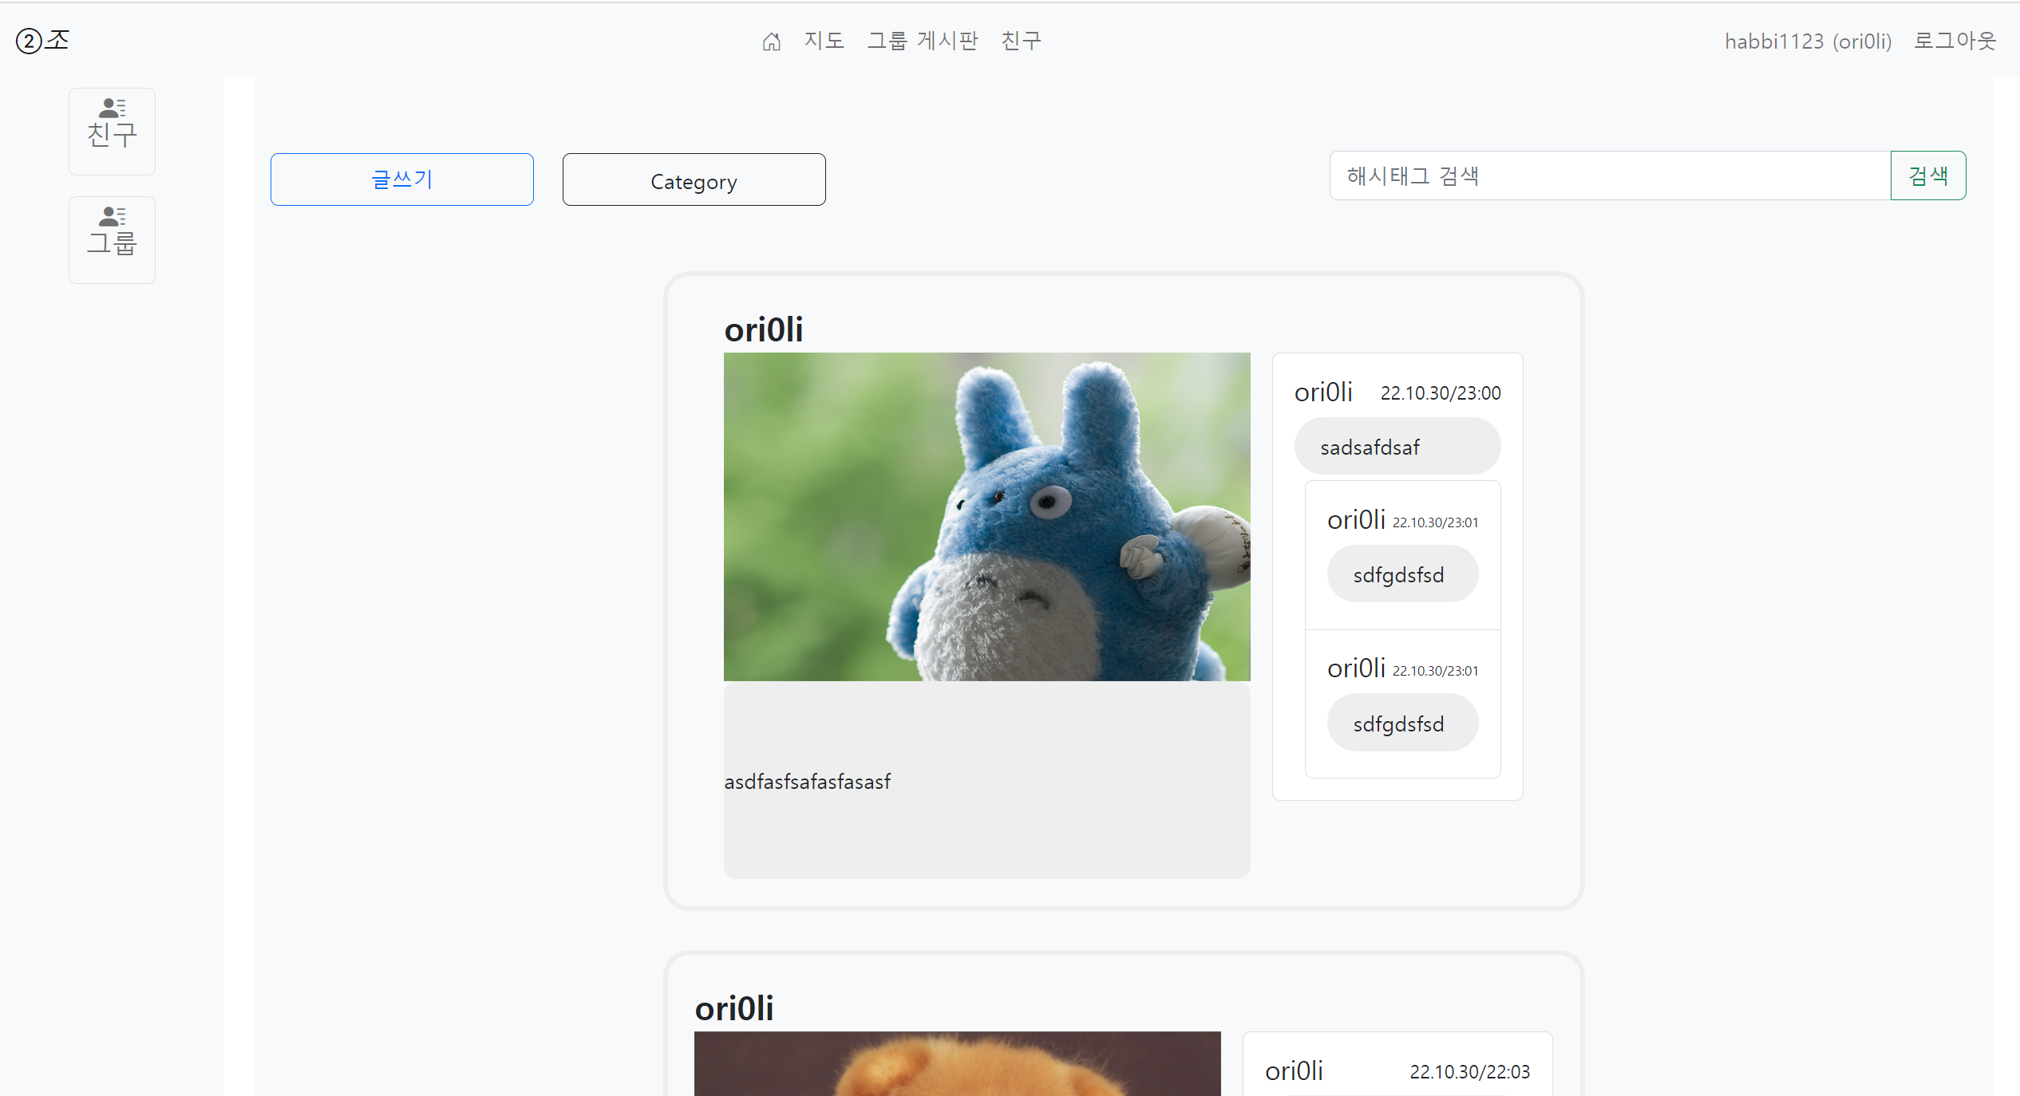
Part 2
Main Board

Slide 7
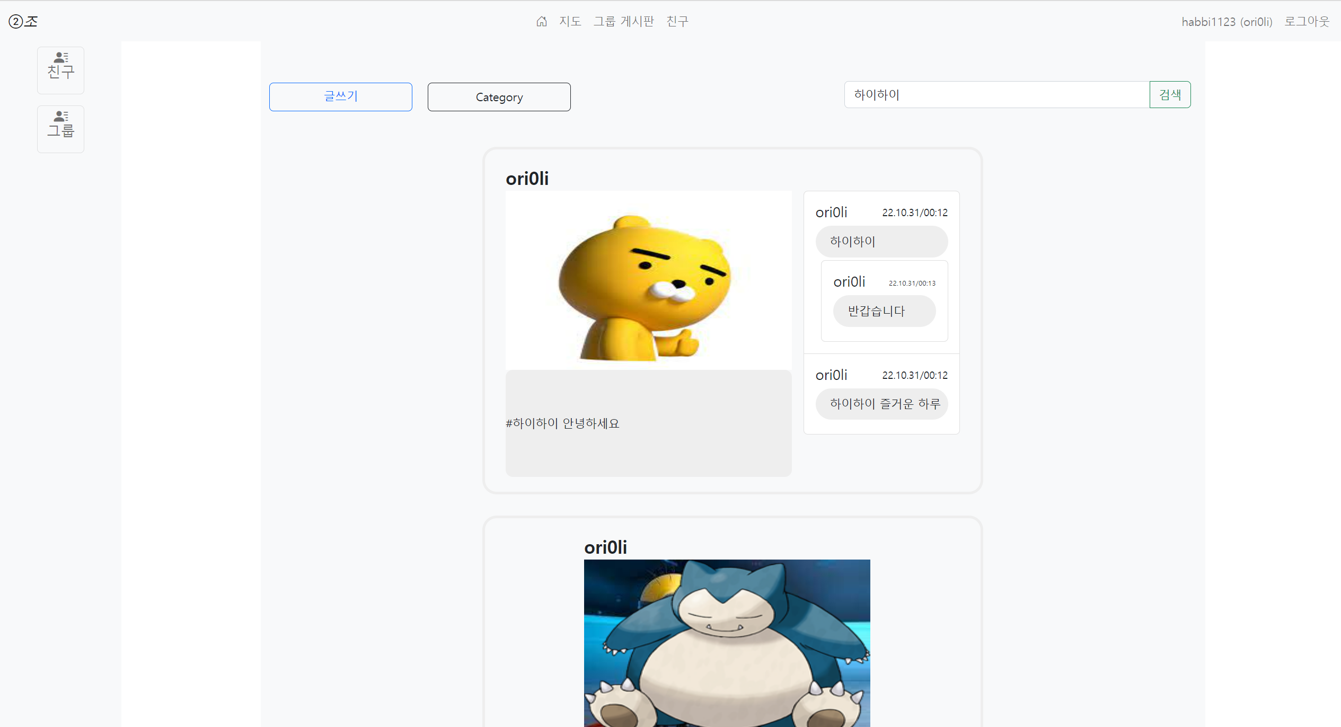
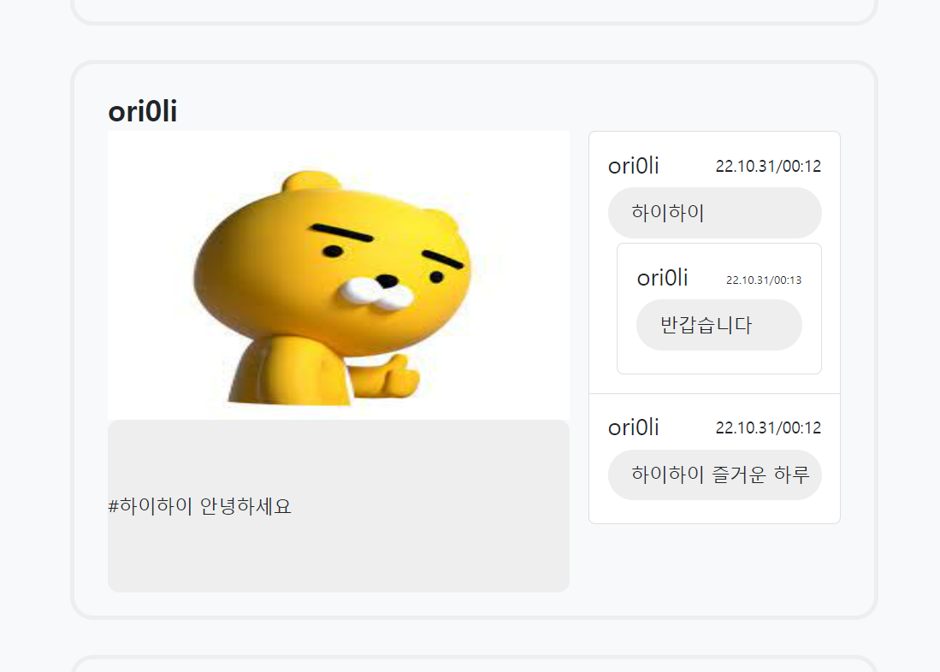
Main Board(hashTag)

Slide 8
Main Board

Slide 9
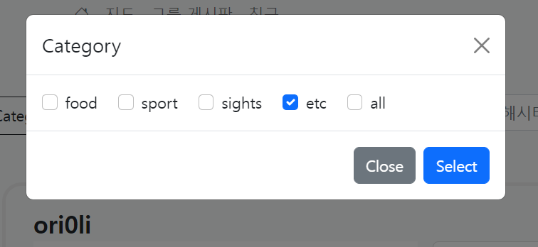
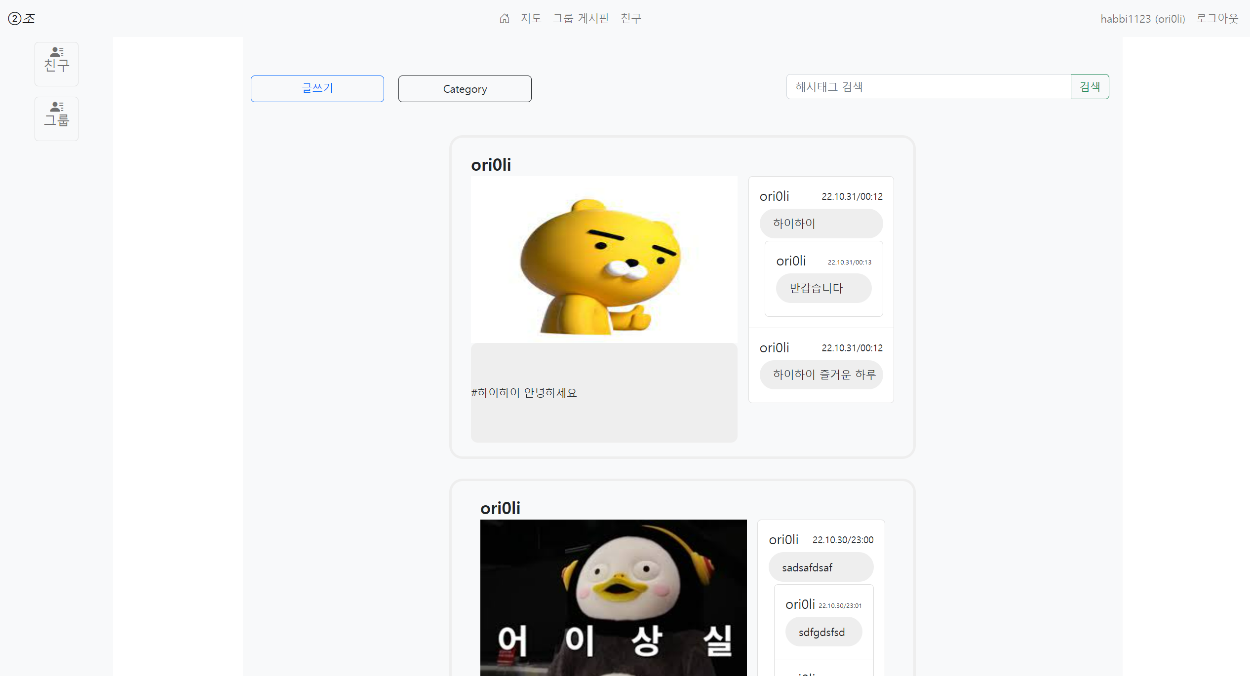
Main Board(category)

Slide 10
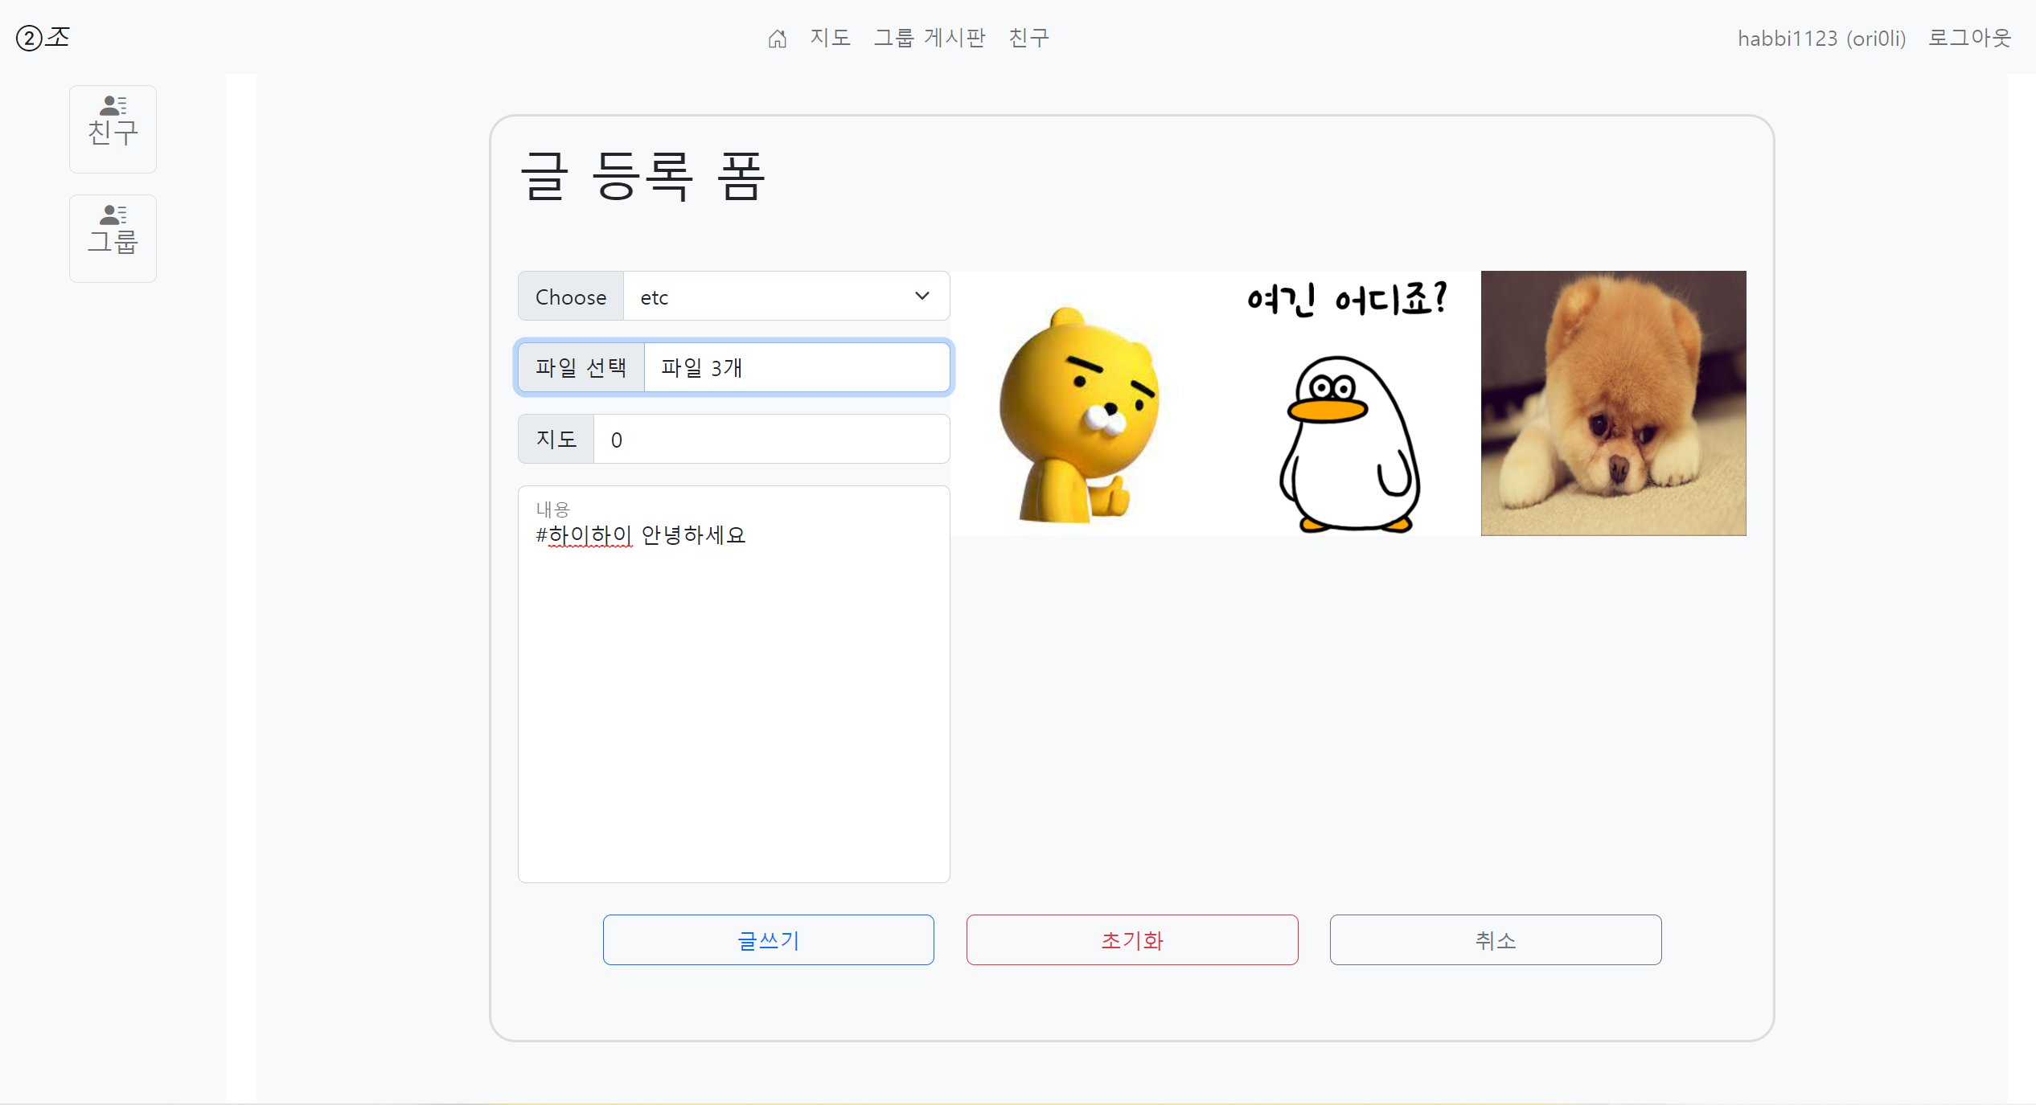
Main Board(insert Form)

Slide 11
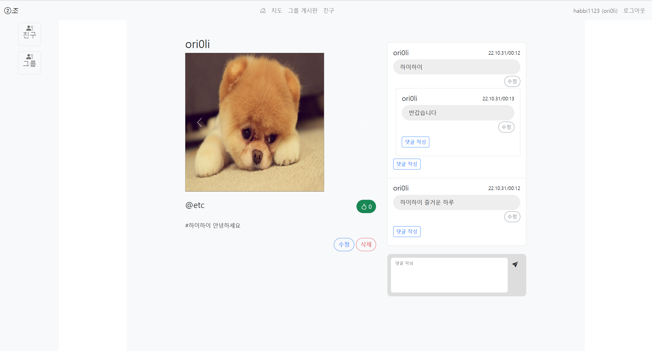
Main Board(detail)

Slide 12
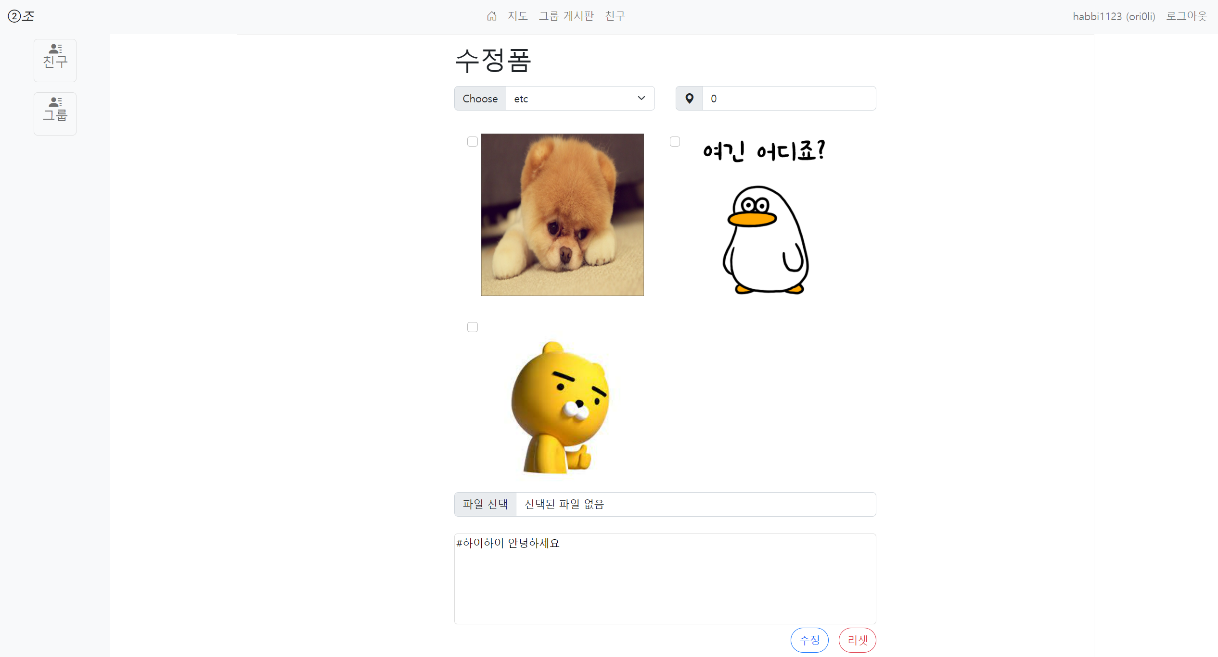
Main Board(update)

Slide 13
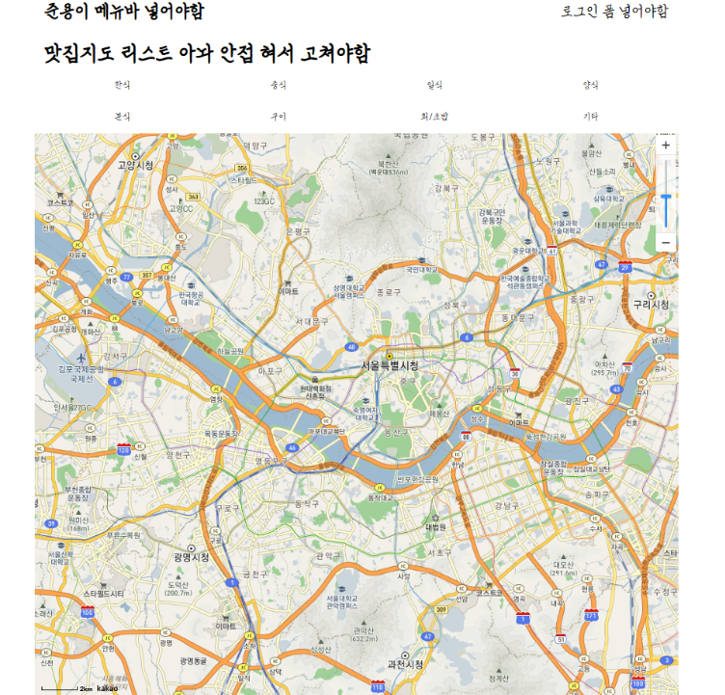
Part 3
Map

Slide 14
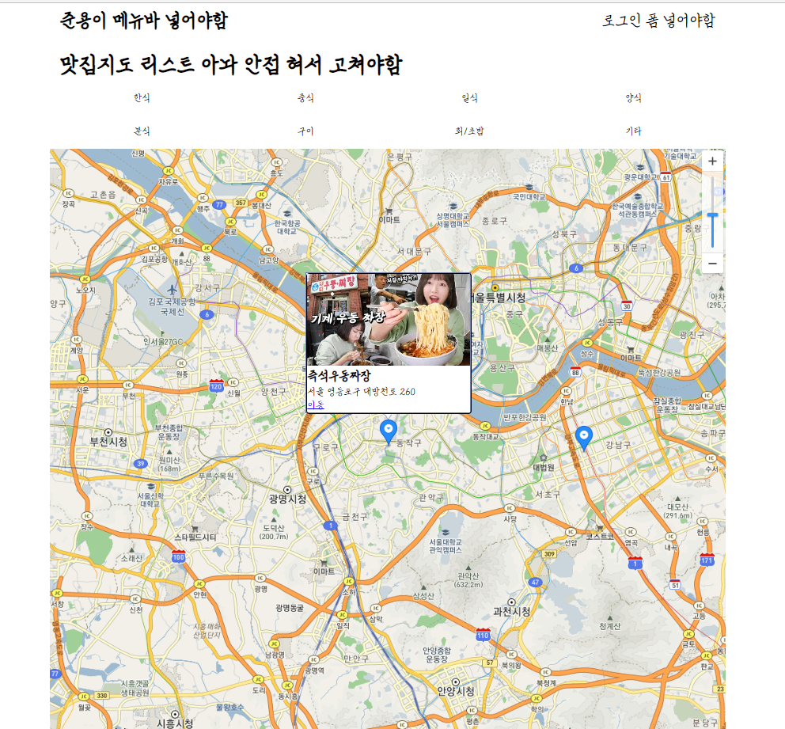
Map

Slide 15
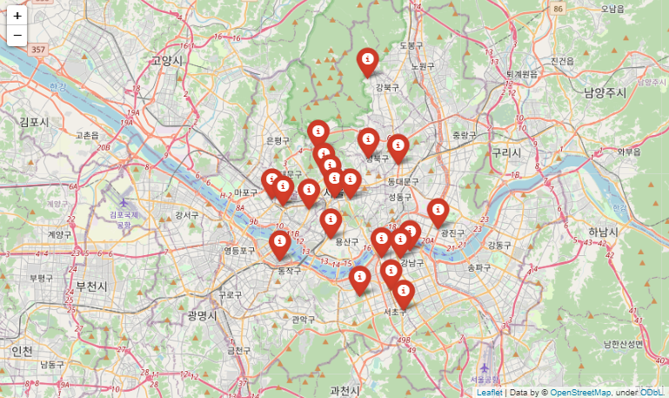
Map

Slide 16
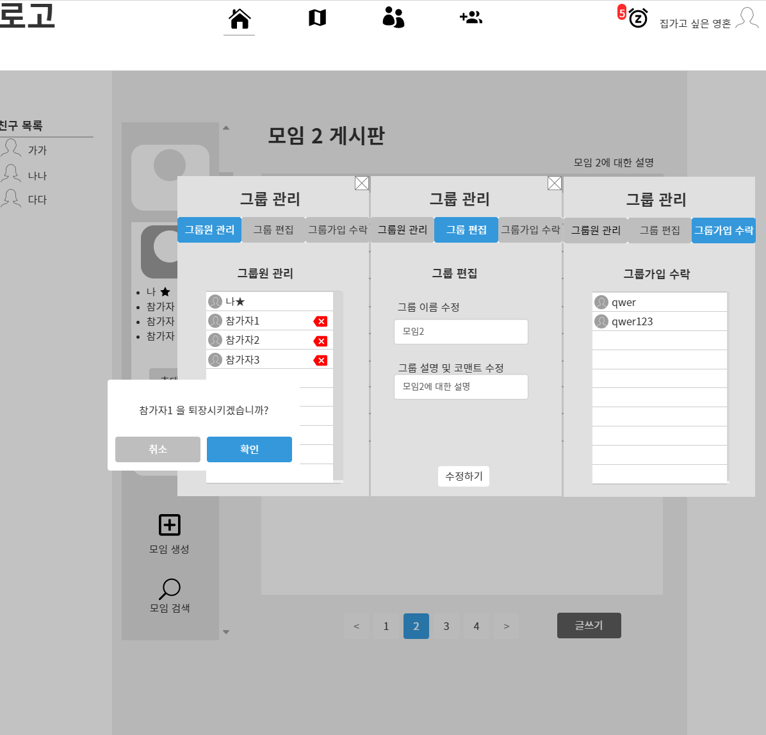
Part 4
Group Board(manage)

Slide 17
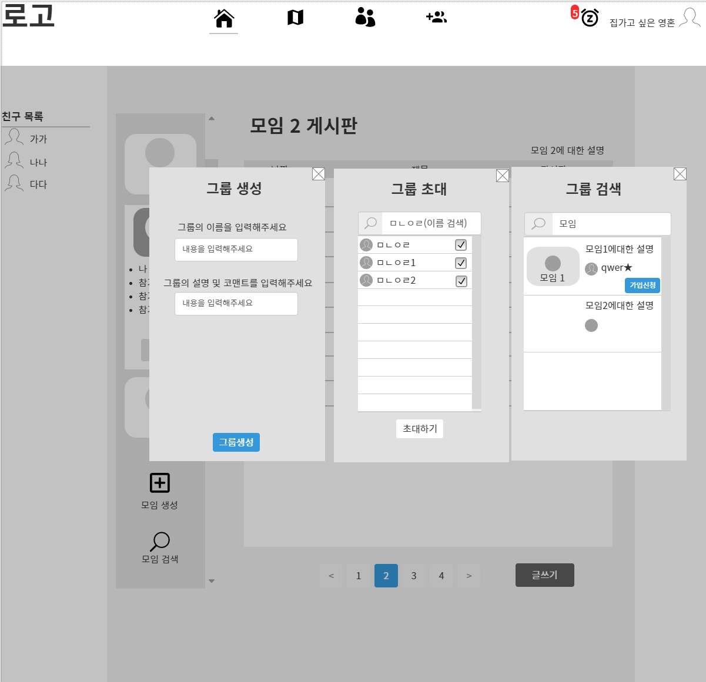
Group Board (insert, search)

